Slide 1
HTML
Class X

Slide 2
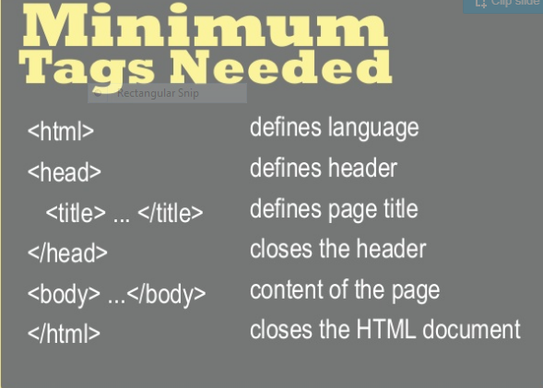

Slide 3
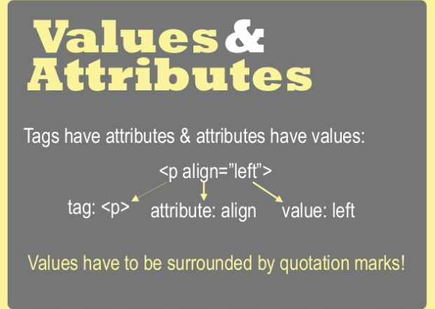

Slide 4
What is HTML, Tag, Attributes?
What are container tags and Empty tags?
How many styles of heading in HTML?
What is the file extension of HTML code file?
Which tag is used to display data in tabular form?
How can you see the source code of webpage?
How to see the web page of respective code?
Which tag and attribute is used to set image as background?
Difference between body tag attributes-background and bgcolor?
What are lists type?

Slide 5
HTML 1

Slide 6
BODY tag ATTRIBUTES
1.background
2.bgcolor
3.leftmargin
4.topmargin
BODY TAGS
<BODY background=” E:\HTML X\nature.jpg ”>
<BODY bgcolor=”magenta”>
<BODY leftmargin= 40 >
<BODY topmargin= 80 >
</BODY >

Slide 7
Heading Tag
{H1......H6}
<H1>Level 1 largest text size</H1>
<H2>Level 2 text size</H2>
<H3>Level 3 text size</H3>
<H4>Level 4 text size</H4>
<H5>Level 5 text size</H5>
<H6>Level 6 smallest size</H6>

Slide 8
<BR>
To leave the blank line space between two lines or paragraph
<BR>
<HR>
To draw the horizontal line
Attributes are size and width
<HR size=4 width=”50%”>
<br>
<br>
<HR size=4 width=200>

Slide 9
Paragraph tag attribute
<p align=left>this text is left align</p>
<p align=right>this text is right align</p>
<p align=center>this text is center align</p>
<p>paragraph</p>

Slide 10
Basefont
<BASEFONT size=5>
This text has basefont size 5
<BASEFONT size=+2>
This text has basefont size bigger than the previous font size
<BASEFONT size=-1>
This text has basefont size -1 than the previous font size

Slide 11
FONT
<FONT size=7>
This text has font size 7
</FONT>
<FONT color=blue>
This text has font color blue
</FONT>
<FONT face=Arial>
This text has font type Arial
</FONT>

Slide 12
Text style
Logical-<em>,<code>,<strong>,<var>....
physical-<B>, <I>, <U>, <TT>
<p>logical style of text</p><br>
<B>The text written here is the bold in style</B><br>
<I>The text is in italic style </I><br>
<U>The text is in underline style</U>

Slide 13


Sub
script
Superscript
<P>X<sub>2</sub></p>
<P>X<sup>2</sup></p>

Slide 14
Special Characters
<
>
&
&lt for <
&gt for >
&amp for &
<p> &lt <br>
<p> &gt <br>
<p>&amp <br>

Slide 15
List and numbers
1.Numbered or ordered<OL>
2.Unnumbered or unordered<UL>
<OL>
<LI>apples
<LI>bananas
<LI>grapefruit
</OL>
<UL>
<LI>Star
<LI>Moon
<LI>Planet
</UL>

Slide 16
Ordered list attribute
1.Type
2.Start
<OL start = 6 type=A>
<LI>alphabet A
<LI>alphabet B
<LI>alphabet C
</UL>
<OL type=i>
<LI>One
<LI>Two
<LI>Three
</UL>

Slide 17
Unordered list
1.Disc
2.Circle
3.Square
<UL type=disc>
<LI>Star
<LI>Moon
<LI>Planet
</UL>
<UL type=circle>
<LI>Star
<LI>Moon
<LI>Planet
</UL>
<UL type=square>
<LI>Star
<LI>Moon
<LI>Planet
</UL>

Slide 18
HTML 2
Images
Links
Table

Slide 19
Inserting Images, supports-
Gif
XBM(xbitmap)
Jpeg
<img src=” ”>
<img src=” ” alt=”this is the image”>
<img src=” ” >

Slide 20
<img src="E:\HTML X\book.jpg" alt="click to image">

Slide 21
TABLE ATTRIBUTES
TABLE TAGS
Border
bordercolor
Bgcolor
Cellspacing
Cellpadding
<TABLE>
<TH>
<TR>
<TD>

Slide 22
Draw Table
rowspan
Item sold | price | quantity
Shampoo | 98 | 30
Biscuit | 45
The bill contains gst
Colspan

Slide 23
Introduction to web page designing using HTML: create and save an HTML document, and access a web page using a web browser.
• HTML tags: html, head, title, body, (attributes: text, background, bgcolor, link, vlink, alink), br (break), hr(horizontal rule), inserting comments, h1..h6 (heading), p (paragraph), b (bold), I (italics), u (underline), ul (unordered list), ol (ordered list), and li (list item). Description lists: dl, dt, and dd. Attributes of ol (start, type), ul (type).
• Font tags (attributes: face, size, color).
• Insert images: img (attributes: src, width, height, alt), superscript), sub (subscript).
• HTML Forms: Textbox, radio buttons, checkbox, password, list, Combobox.
• Embed audio and video in an HTML page.
• Create a table using the tags: table, tr, th, td, row span, colspan
• Links: significance of linking, anchor element (attributes: href, mailto), targets.
• Cascading style sheets: color, background-color, border style, margin, height, width, outline, font (family, style, size), align, float.

Slide 24
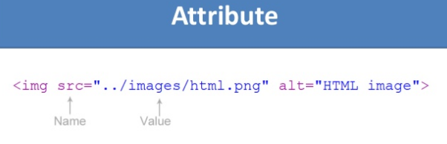

Slide 25
Linking
External Linking
IInternal Linking
<A href="https://www.google.com/"> Google</A>
A saperate tab will open
<A href="jaipuria.docx"> Google</A>
Same browser, file will open

Slide 26
IInternal Linking
Also used as section linking in the same document
Section set-
<A name=”elephant A”> elephent section </A>
Link to this section Section -
<A name=”#elephant A”> elephent link </A>
Link to the section of other document
<A href=”main.docx#elephantlink> elephant link</A>

Slide 27
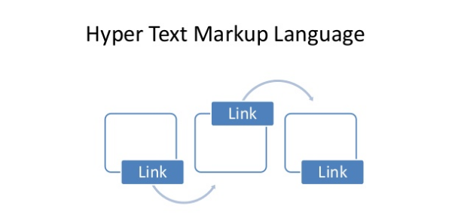

Slide 28
Sending Email from a Browser
<A href=”mailto:publisher@gmail.com?subject=’to order book’ “> mail to </A>

Slide 29


Slide 30
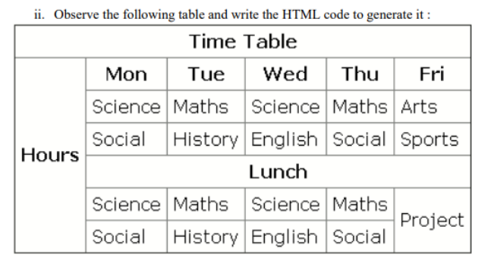

Slide 31
CSS
HTML----CSS-----Javasxript-----DOM(document object model)

Slide 32
Dynamic web page
Static VS Dynamic

Slide 33
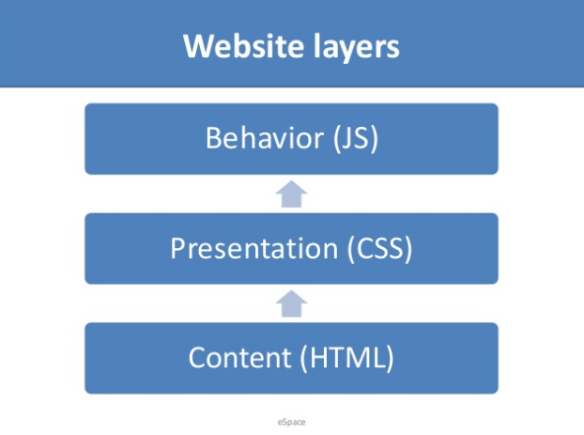

Slide 34
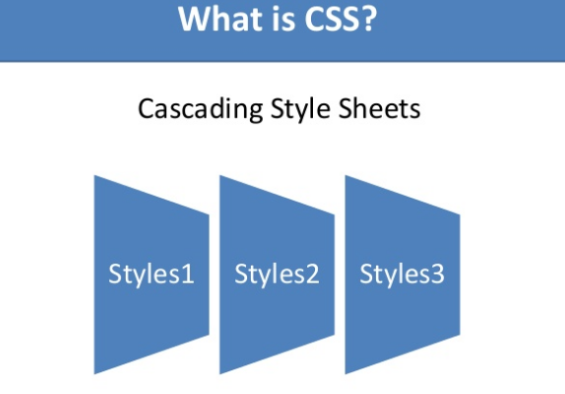

Slide 35
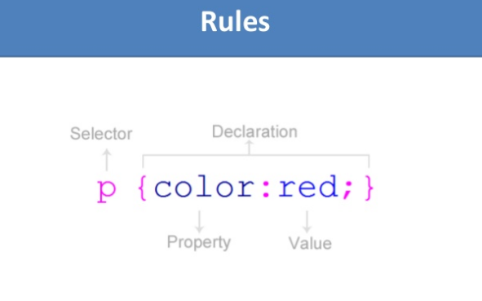

Slide 36
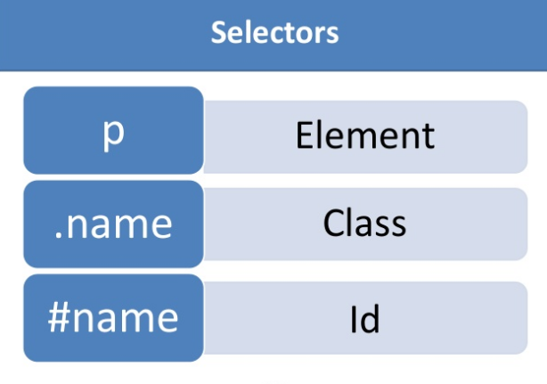

Slide 37
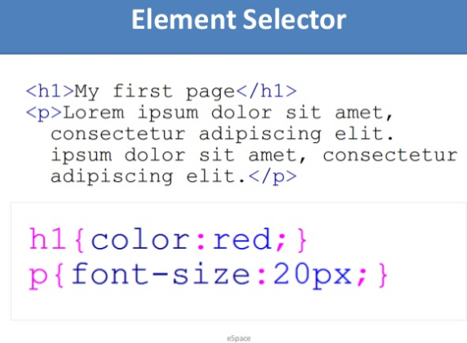
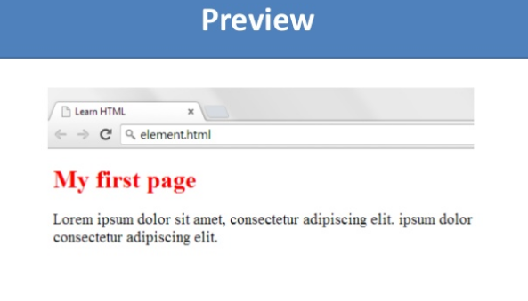

Slide 38
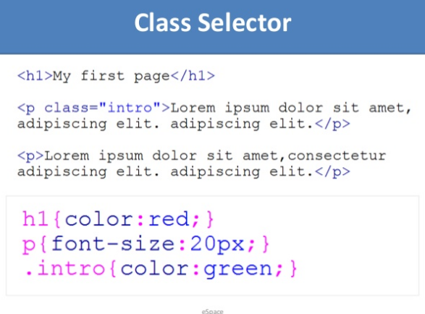
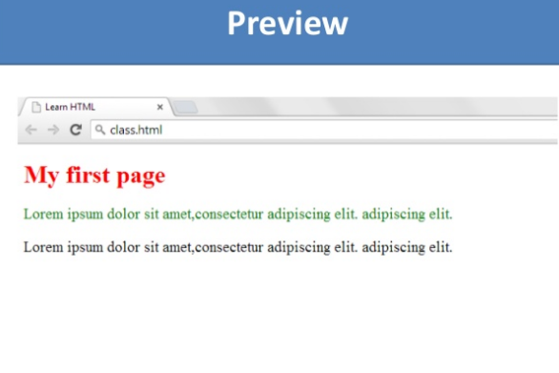

Slide 39
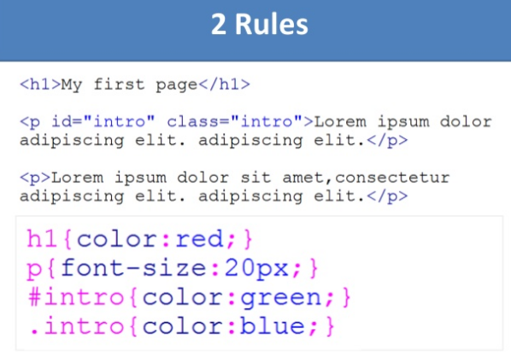
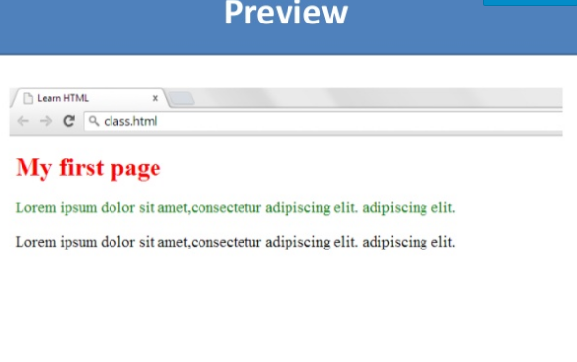

Slide 40
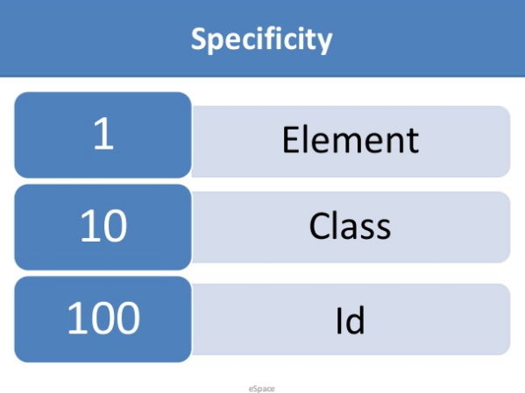

Slide 41
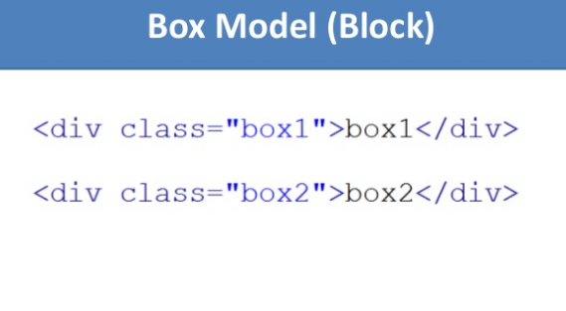

Slide 42
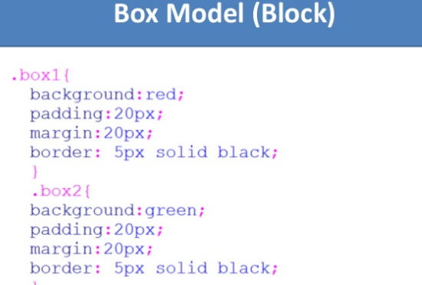
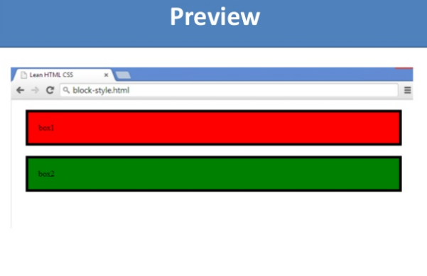

Slide 43
